Slide 1
Basic Trigonometry

Slide 2
Trigonometry means “triangle” and “measurement”.
We will be using right-angled triangles.
Opposite
hypotenuse
a°
Adjacent

Slide 3

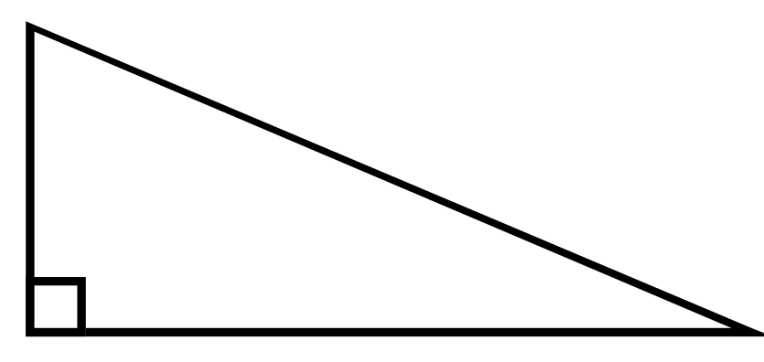
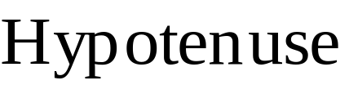




Parts of a Right Triangle
The hypotenuse will always be the longest side, and opposite from the right angle.
Imagine that you are at Angle A looking into the triangle.
The opposite side is the side that is on the opposite side of the triangle from Angle A.
The adjacent side is the side next to Angle A.

Slide 4
Important to know:
Hypotenuse
Opposite
θ
Adjacent

Slide 5
Parts of a Right Triangle
Now imagine that you move from Angle A to Angle B.
From Angle B the opposite side is the side that is on the opposite side of the triangle.
From Angle B the adjacent side is the side next to Angle B.

Slide 6
Important to know:
θ
Hypotenuse
Adjacent
Opposite

Slide 7
The Trigonometric Ratios
SINE
COSINE
TANGENT

Slide 8
SINE
Prounounced “sign”

Slide 9
COSINE
Prounounced “co-sign”

Slide 10
TANGENT
Prounounced “tan-gent”

Slide 11
Greek Letter θ
Prounounced “theta”
Represents an unknown angle
Sometimes called the reference angle or angle of perspective

Slide 12
Trigonometry Ratios
Opp
Adj
Opp
Sin θ° =
Cos θ °=
Tan θ°=
Hyp
Hyp
Adj
S^{O}H
C^{A}H
T^{O}A

Slide 13

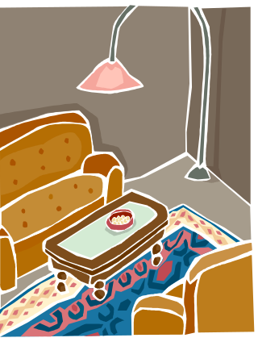
Some
Old
Hippie
Came
A
Hoppin’
Through
Our
Old Hippie
Apartment

Slide 14
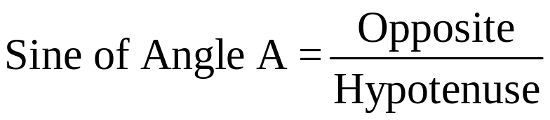
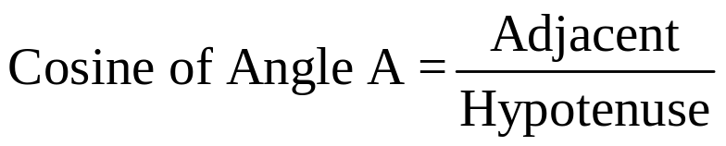
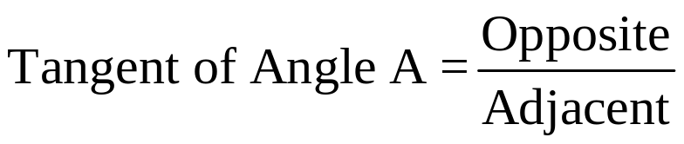
Trig Ratios
Hypotenuse
Each of the 3 ratios has a name
The names also refer to an angle
Opposite
A
Adjacent

Slide 15
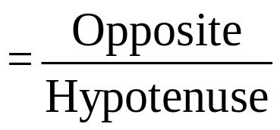


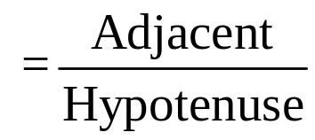

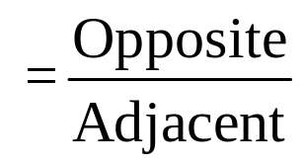


Trig Ratios
B
If the angle changes from A to B
Hypotenuse
Opposite
A
The way the ratios are made is the same
Adjacent

Slide 16
Finding sin, cos, and tan.
(Just writing a ratio or decimal.)

Slide 17
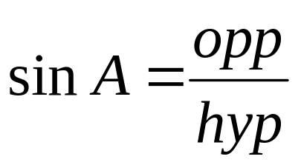
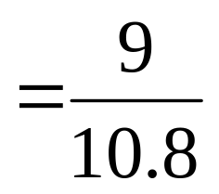

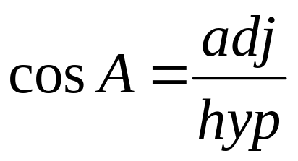
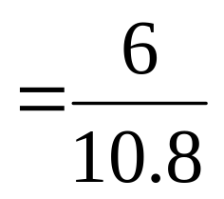


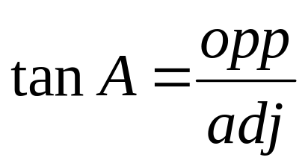
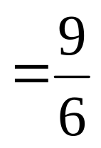


Find the sine, the cosine, and the tangent of angle A.
Give a fraction and decimal answer (round to 4 places).
10.8
9
A
6
Shrink yourself down and stand where the angle is.
Now, figure out your ratios.

Slide 18
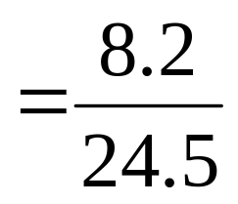

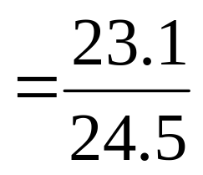

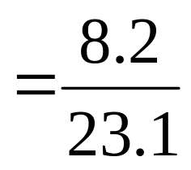

Find the sine, the cosine, and the tangent of angle A.
Give a fraction and decimal answer (round to 4 decimal places).
24.5
8.2
A
23.1
Shrink yourself down and stand where the angle is.
Now, figure out your ratios.

Slide 19
Finding a side.
(Figuring out which ratio to use and getting to use a trig button.)

Slide 20
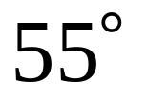
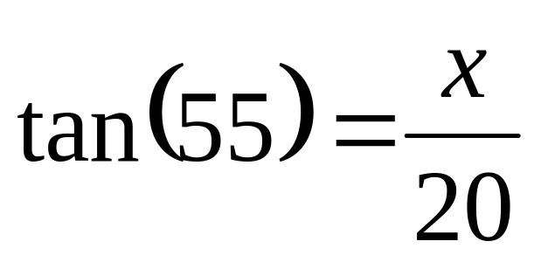
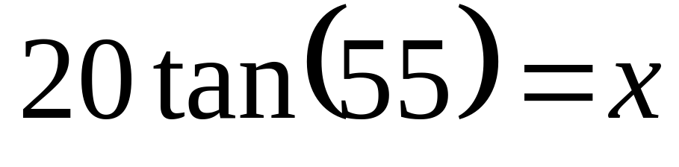
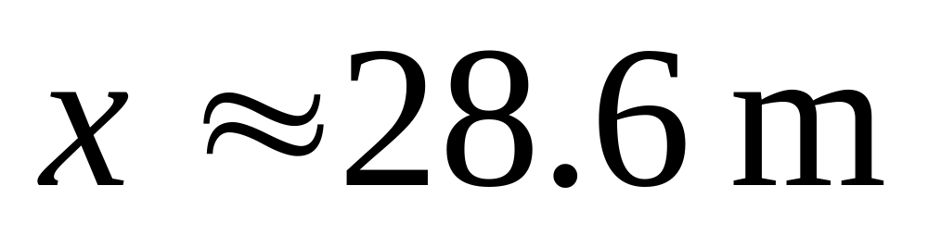
Ex: 1 Figure out which ratio to use. Find x. Round to the nearest tenth.
20 m
x
Shrink yourself down and stand where the angle is.
20
tan
55
)
Now, figure out which trig ratio you have and set up the problem.

Slide 21
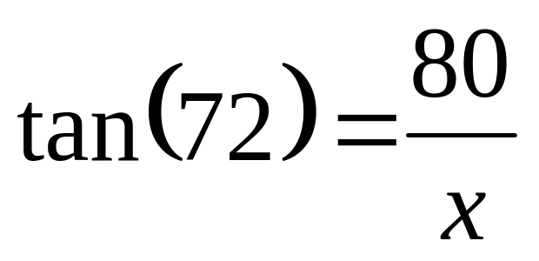
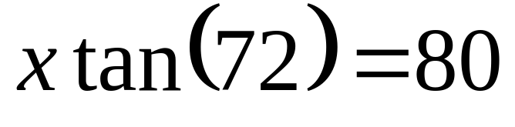
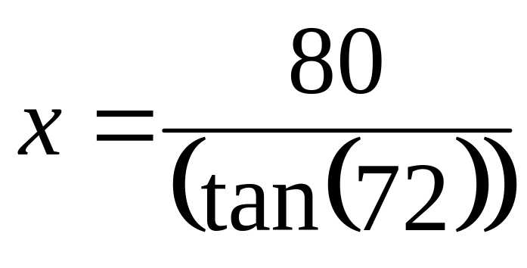
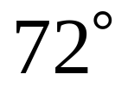
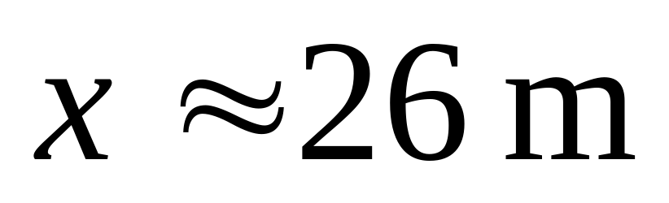
Ex: 2 Find the missing side. Round to the nearest tenth.
80 m
x
80
÷
(
tan
72
)
)
=
Shrink yourself down and stand where the angle is.
Now, figure out which trig ratio you have and set up the problem.

Slide 22
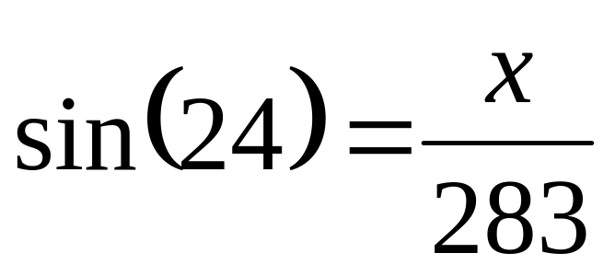
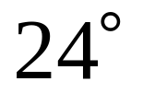
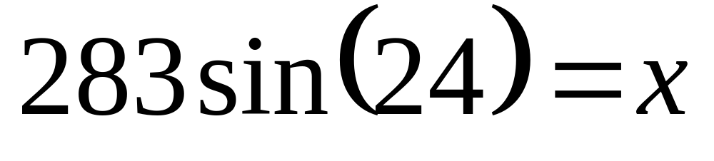
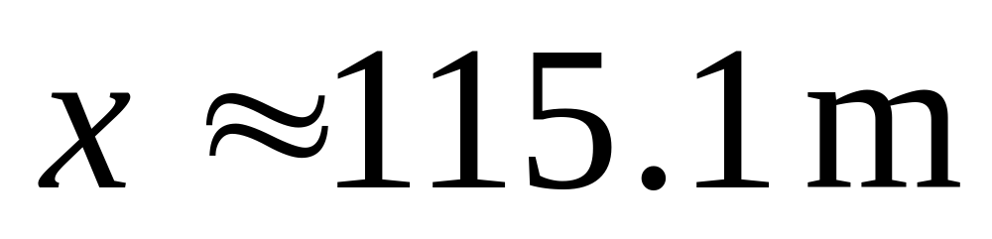
Ex: 3 Find the missing side. Round to the nearest tenth.
283 m
x
Shrink yourself down and stand where the angle is.
Now, figure out which trig ratio you have and set up the problem.

Slide 23
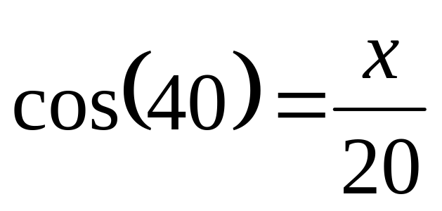
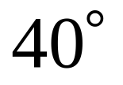
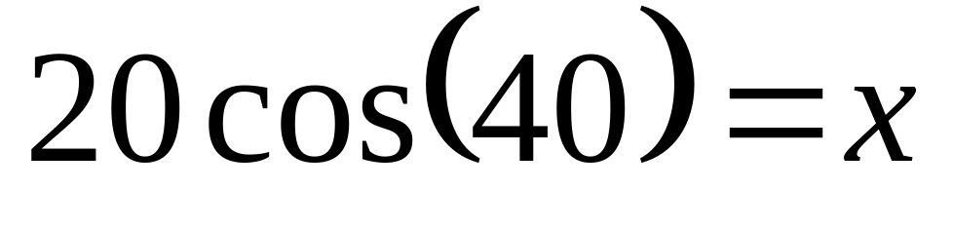
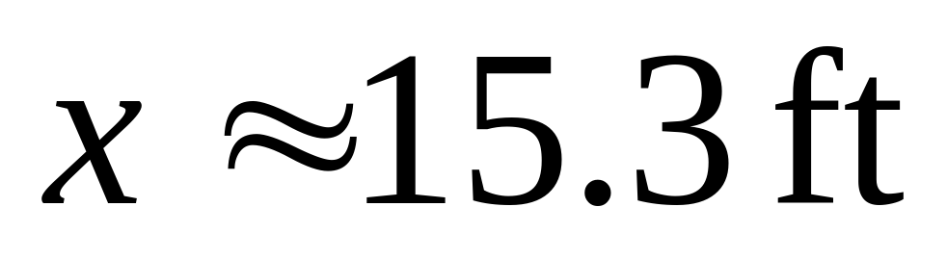
Ex: 4 Find the missing side. Round to the nearest tenth.
20 ft
x

Slide 24
Finding an angle.
(Figuring out which ratio to use and getting to use the 2nd button and one of the trig buttons.)

Slide 25
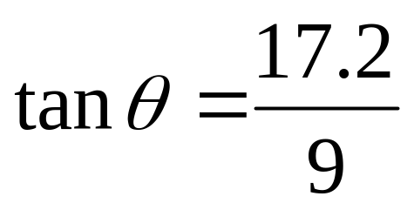
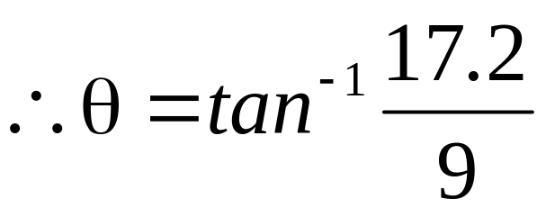
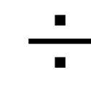
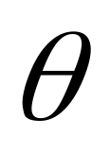
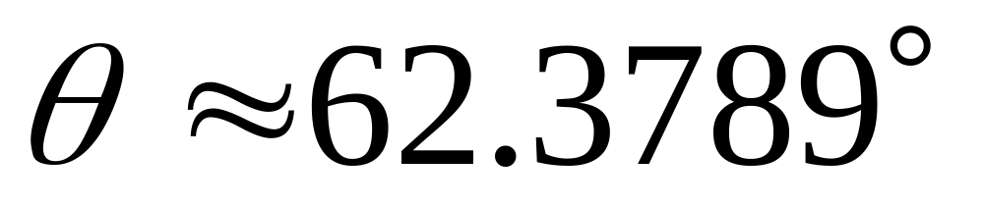
Ex. 1: Find θ. Round to four decimal places.
2nd
tan
17.2
9
)
17.2
9
Shrink yourself down and stand where the angle is.
Now, figure out which trig ratio you have and set up the problem.

Slide 26
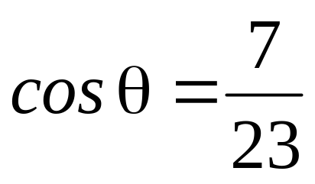
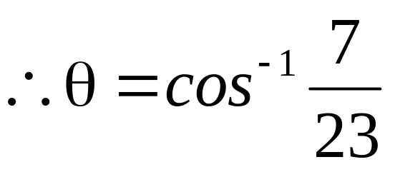
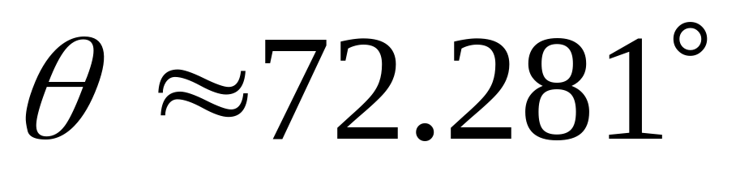
Ex. 2: Find θ. Round to three decimal places.
7
2nd
cos
7
23
)
23
Make sure you are in degree mode (not radians).

Slide 27
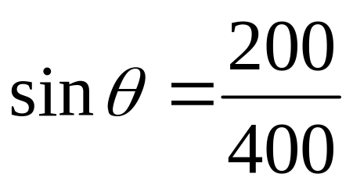
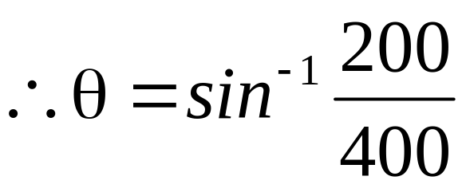
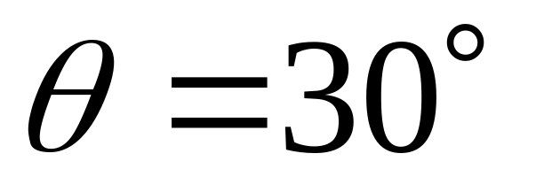
Ex. 3: Find θ. Round to three decimal places.
200
400
2nd
sin
200
400
)

Slide 28
When we are trying to find a side we use sin, cos, or tan.
When we are trying to find an angle
we use sin⁻¹, cos⁻¹, or tan⁻¹.

